Slide 1
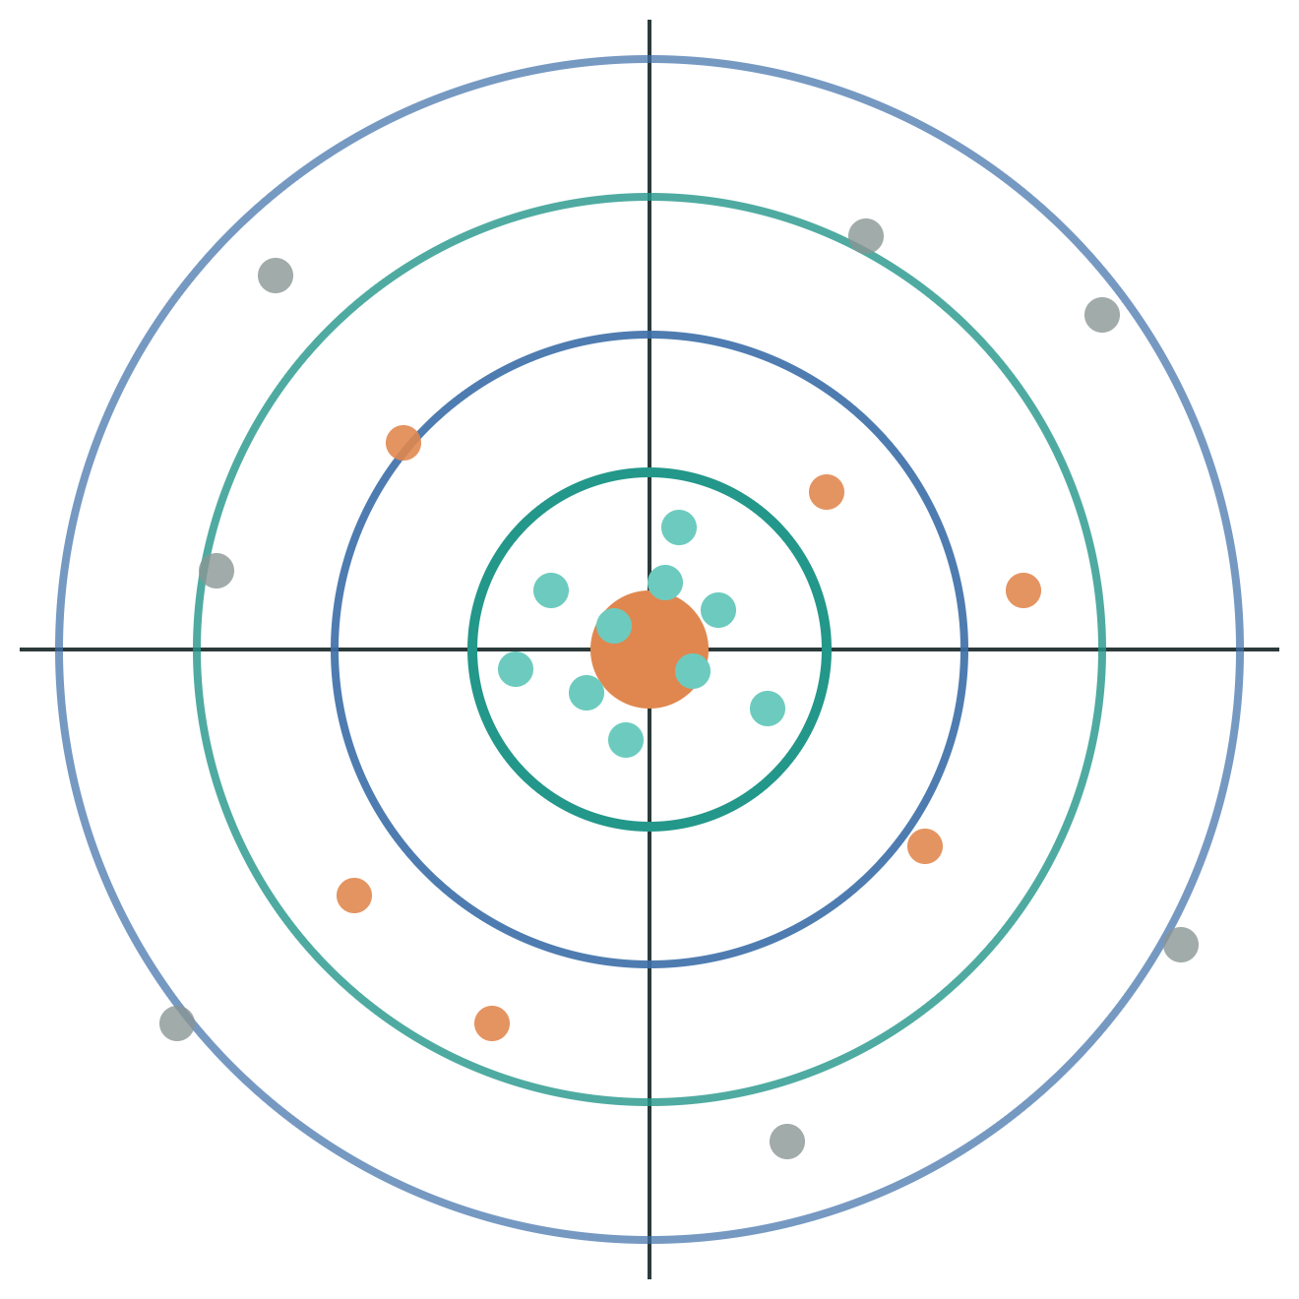
Classification Evaluation Metrics
NDL
NITTANY DATA LAB
Meeting #2 · November 1

Slide 2
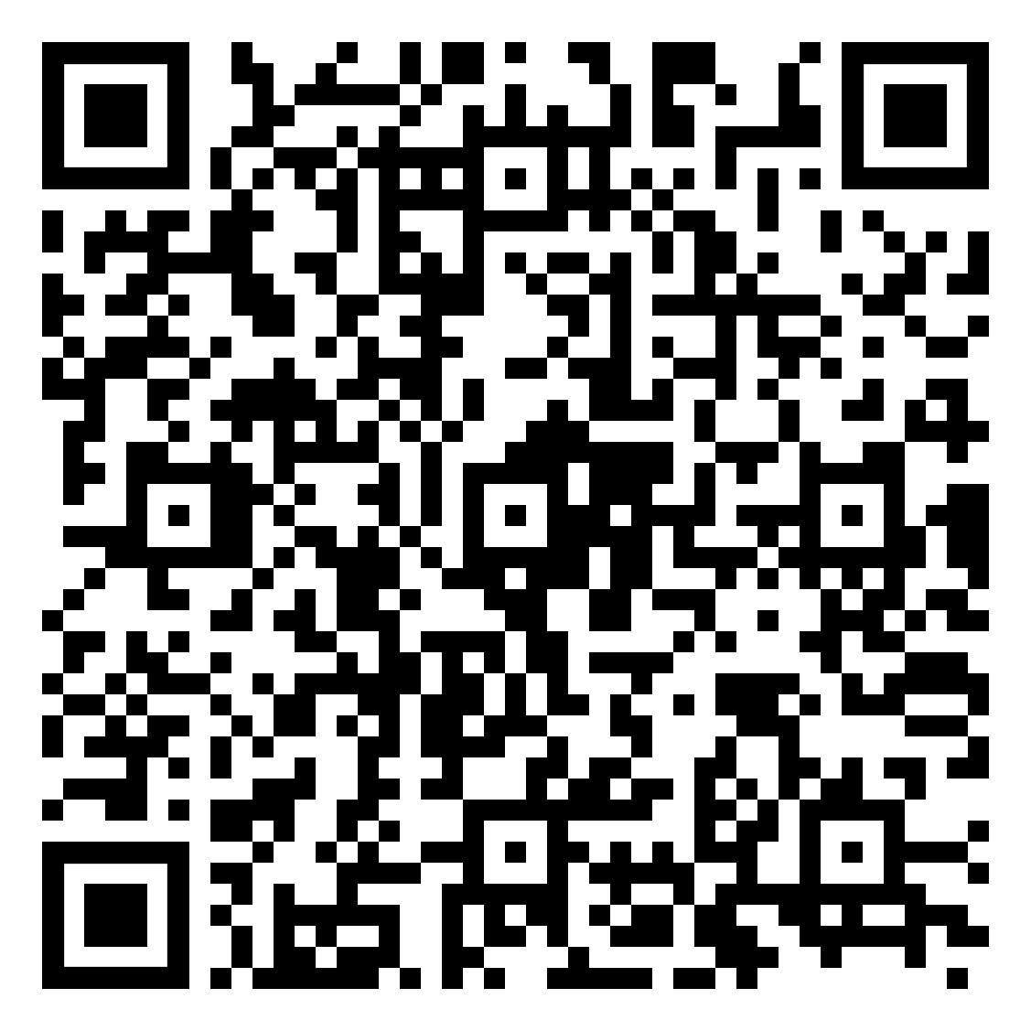

ATTENDANCE
Meeting Name: “Evaluation Metrics”
Attendance QR code
Replace this box

Slide 3
88%
Our model is 88% accurate.
Should the bank use it?

Slide 4
A model that predicts “no” for every client is 88% accurate and finds zero subscribers
39,922 (88.3%)
THE LAZY MODEL
Always predict “no”
Accuracy
88.3%
5,289 (11.7%)
Subscribers found
0 of 5,289
Last week we fixed the class imbalance. This week we learn to measure what a model actually gets right.
No
Yes (subscribed)
Source: Bank Marketing dataset (bank-full.csv, Kaggle), 45,211 clients
NDL

Slide 5



Evaluation metrics tell us how a model fails, not just how often it’s right
Spam filter
Cancer screening
Bank marketing
Sorts incoming email into inbox or spam.
Flags scans that need a closer look.
Picks which clients to call about a term deposit.
COSTLIEST MISTAKE
COSTLIEST MISTAKE
COSTLIEST MISTAKE
A real email hidden in spam
A missed tumor
It depends: wasted calls or missed subscribers?
NDL

Slide 6
Every prediction lands in one of four boxes: the confusion matrix
Predicted: No
Predicted: Yes
TP: we called, they subscribed
TN
FP
FP: we called, they said no
Actual: No
820
60
FN: we skipped a real subscriber
TN: we skipped, they wouldn’t subscribe
FN
TP
Dark teal diagonal = correct. Orange = mistakes. Every metric that follows is built from these four numbers.
Actual: Yes
48
72
Example: 1,000 clients, 120 of them real subscribers
NDL

Slide 7
Accuracy measures the share of all predictions that were correct
Pred. No
Pred. Yes
TP + TN
Accuracy =
TN
FP
TP + TN + FP + FN
Actual No
820
60
Example: (72 + 820) ÷ 1,000 = 89.2%
FN
TP
Actual Yes
USE IT WHEN
WATCH OUT
48
72
Classes are roughly balanced
The lazy model scores 88% too
NDL

Slide 8
Precision asks: of everyone we predicted “yes,” how many actually were?
Pred. No
Pred. Yes
TP
Precision =
TN
FP
TP + FP
Actual No
820
60
Example: 72 ÷ (72 + 60) = 54.5%
FN
TP
Actual Yes
BANK QUESTION
USE IT WHEN
48
72
Of the clients we called, how many subscribed?
False alarms are costly, like a spam filter
NDL

Slide 9
Recall asks: of everyone who actually was “yes,” how many did we catch?
Pred. No
Pred. Yes
TP
Recall =
TN
FP
TP + FN
Actual No
820
60
Example: 72 ÷ (72 + 48) = 60.0%
FN
TP
Actual Yes
BANK QUESTION
USE IT WHEN
48
72
Of all real subscribers, how many did we reach?
Misses are costly, like screening or fraud
Also called sensitivity or true positive rate (TPR)
NDL

Slide 10
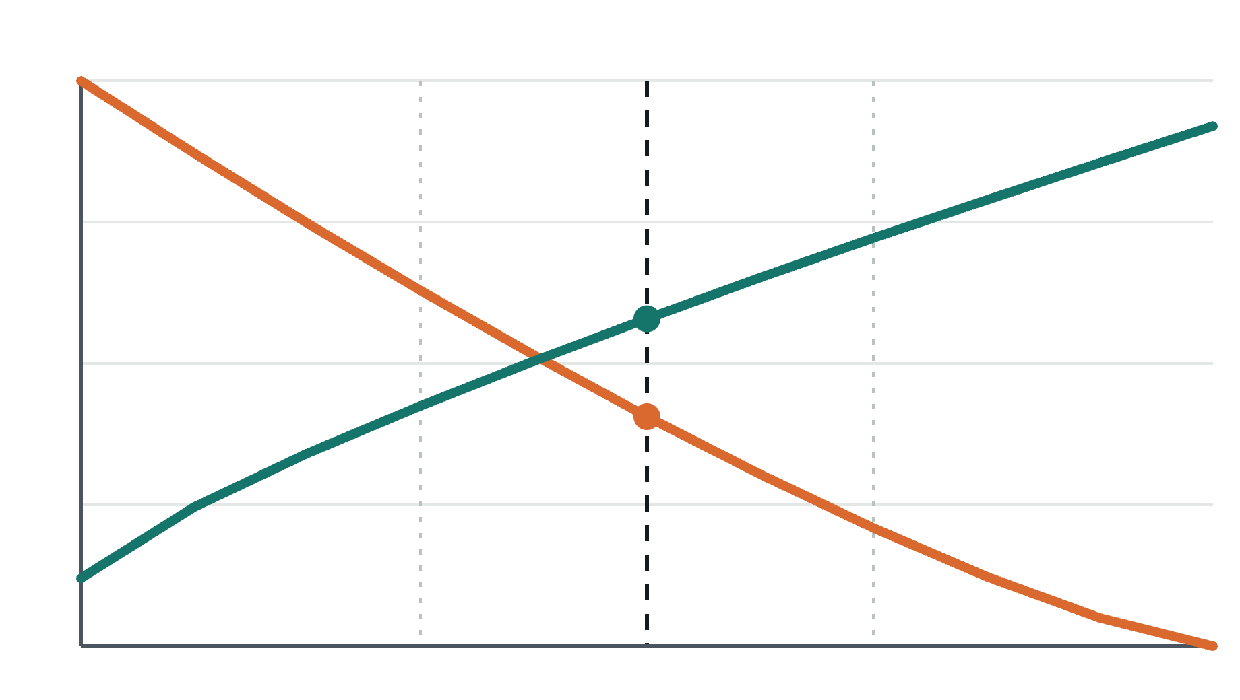
Moving the decision threshold trades precision for recall
Score
Default 0.5
Precision
Recall
Lower threshold (0.3)
Call more clients. Recall rises, precision falls.
Higher threshold (0.7)
Call only the surest clients. Precision rises, recall falls.
The model outputs a probability. The threshold turns it into yes or no.
0
0.3
0.5
0.7
1.0
Decision threshold
Illustrative curves. Plot your own with precision_recall_curve in the Colab.
NDL

Slide 11
F1 score combines precision and recall, and punishes a model that ignores either
WHY NOT JUST AVERAGE?
2 × Precision × Recall
Model | Precision | Recall | Average | F1
A | 0.90 | 0.10 | 0.50 | 0.18
B | 0.55 | 0.60 | 0.58 | 0.57
F1 =
Precision + Recall
Our example: 2 × 0.545 × 0.600 ÷ (0.545 + 0.600) = 0.571
Model A looks fine on average but almost never finds a subscriber. F1 exposes it.
Range 0 to 1, higher is better. It’s the harmonic mean, so one low score drags the whole thing down.
A strong default for imbalanced data like ours
NDL

Slide 12
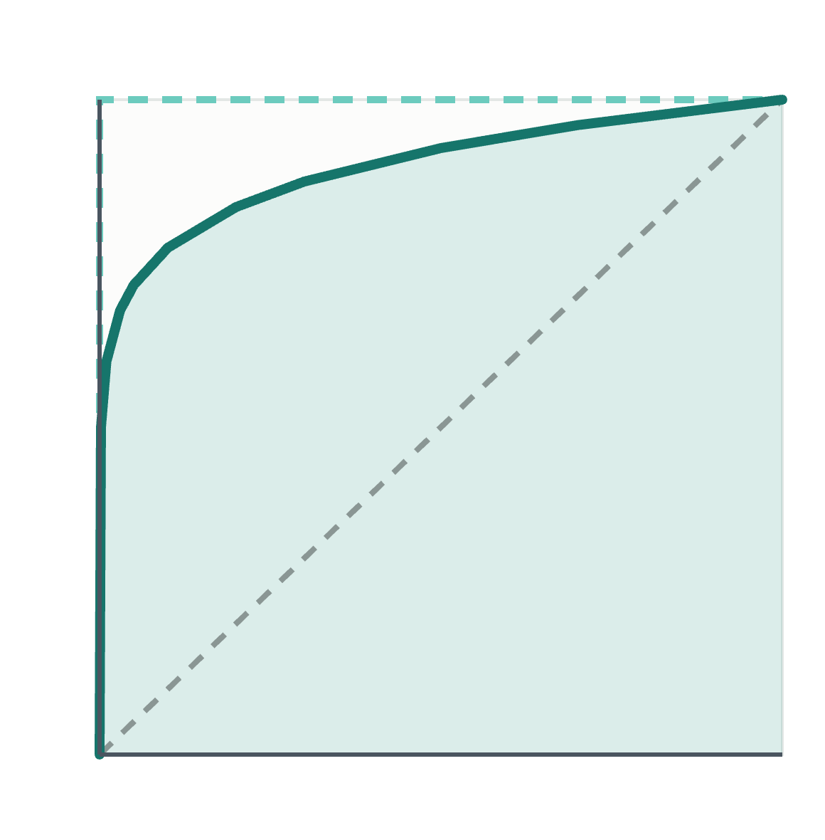
The ROC curve tests every threshold at once, and AUC sums it up in one number
True positive rate (recall)
Perfect model
AUC = 1.0
1
Strong model
AUC ≈ 0.9
Random guessing
AUC = 0.5
AUC is the chance the model ranks a random subscriber above a random non-subscriber.
The closer the curve hugs the top left corner, the better.
0
False positive rate
1
Illustrative curves. In the Colab: roc_curve and roc_auc_score.
NDL

Slide 13
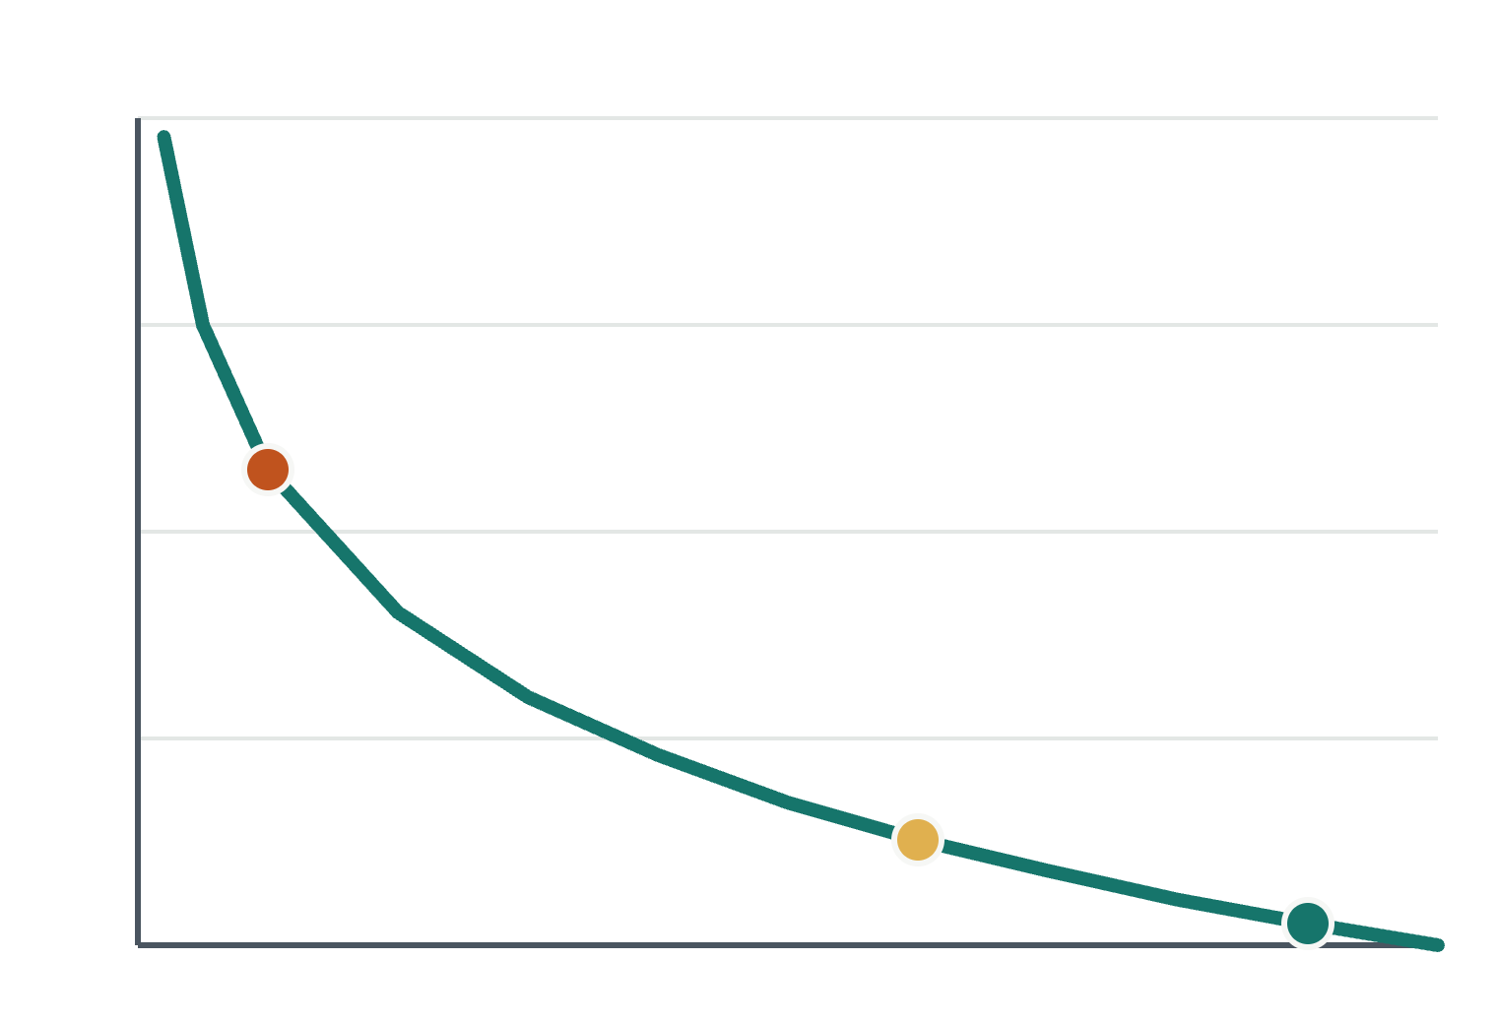
Log loss grades the probabilities and punishes confident wrong answers the most
Loss
THE CLIENT REALLY SUBSCRIBED
Model says 0.9: confident, right
0.11
Model says 0.6: unsure
0.51
Model says 0.1: confident, wrong
2.30
Lower is better. A perfect model scores 0.
0
0.5
1.0
Predicted probability for the true answer
Loss for one prediction = −ln(probability given to the true answer). In the Colab: log_loss.
NDL

Slide 14
The right metric depends on which mistake is more expensive
Scenario | Costlier mistake | Prioritize
Spam filter | False positive: a real email hidden | Precision
Cancer screening | False negative: a missed case | Recall
Fraud detection | False negative: missed fraud | Recall, F1
Bank marketing | You decide | Discuss!
Think about it: one phone call is cheap, but a lost subscriber is lost revenue. Which way should our threshold move?
NDL

Slide 15
Key Takeaways
Beyond Accuracy
TN
FP
Accuracy can look great while missing every positive case
Every metric is built from TP, FP, FN and TN
Core Metrics
Precision: fewer false alarms
Recall: fewer missed positives
F1: a balance of precision and recall
ROC AUC: performance across every threshold
FN
TP
Come back next week when we cover [next week’s topic]

Slide 16
Thank You!
Next Meeting: 11/8 - Classification Modeling

